Slide 1
Nutritional Source Cues:
Social Media Nutrition Credibility: Experimental Evidence
UC Berkeley
April 14th, 2026
Kathy Camp
Gerardo Solis
Shashi Shamarao
Ryan Farhat-Sabet
Zeb Abraham Rosen
DATASCI-241
Section 01 (Tue 4 PM PST)
Notes:
GS

Slide 2
Agenda
UC Berkeley
April 14th, 2026
1.
Experiment Summary
2.
Treatment
3.
Experimental Design
4.
ROXO
5.
Outcome Measurement
6.
Analysis & Results
7.
Questions
Notes:
GS

Slide 3
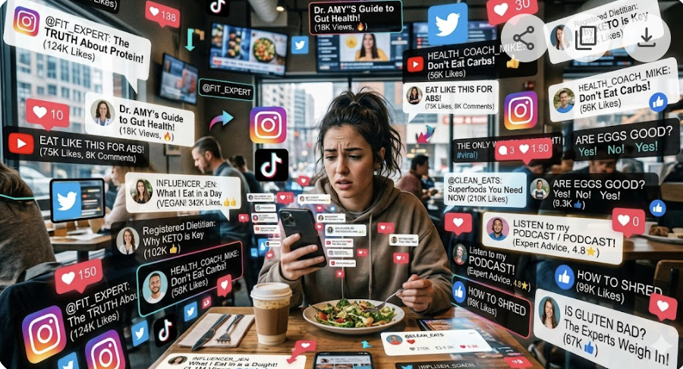
Motivation Behind Experiment
UC Berkeley
April 14th, 2026
Notes:
GS:
In the world we live in today
Information readily available: TV, Phones, Laptops, in the Gym
Varying Sources: News networks, Influencers, Experts
Influencer Source:
Million of followers, Million of Views
Nutriitonal recommendations, advice
Information may or may not be true
Expert Source:
Nutritional recommendations, advice
Do not have a strong social media presence
Personal Expierence:
Falling victim to believing Information coming from influencer’s
Where that advice was incorrect
Why Conduct an experiment:
Observational data cannot differentiate between the effects of the source (influencer vs. expert) and audience biases.
Randomized experiments isolate the source, providing a clear understanding of its impact on perception of credibility.
We want to measure percieved credibility from the source of information
while targeting different demographics to understand how different advice is perceived
Original Content below for refference:
“ Imagine a social media scenario where both influencers and experts post content, and the influencers’ posts receive significantly more views and likes. This can lead us to believe that influencer posts are the most popular. However, it’s crucial to understand the audiences receiving the posts, including their backgrounds, age groups, and other demographics. Since the target audiences for influencers and experts can vary widely, assuming the influencer's post is inherently more popular may lead to incorrect conclusions.
To address these assumptions, it is important to conduct an experiment in which we keep everything constant except for the label, switching between influencer and expert, and target different demographic groups. Comparing the responses from these groups can provide a better understanding of how different advice is perceived and the best way to get evidence-based public health information to be heard. ”

Slide 4
Experiment Summary
UC Berkeley
April 14th, 2026
Research Question
Are expert recommendations perceived as more credible than non-expert recommendations in the context of social media nutritional posts or recommendations?
Hypothesis
Expert source cues will lead people to judge expert recommendations more credible than influencer source cues
Notes:
GS

Slide 5
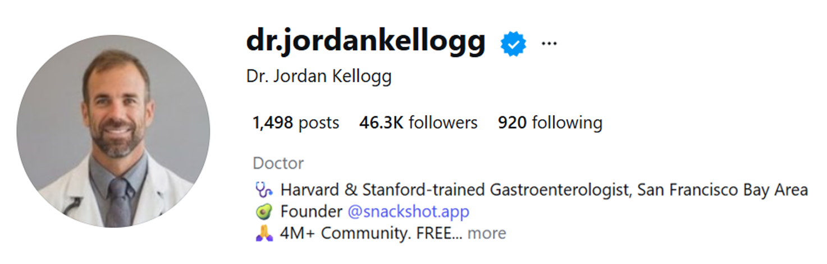
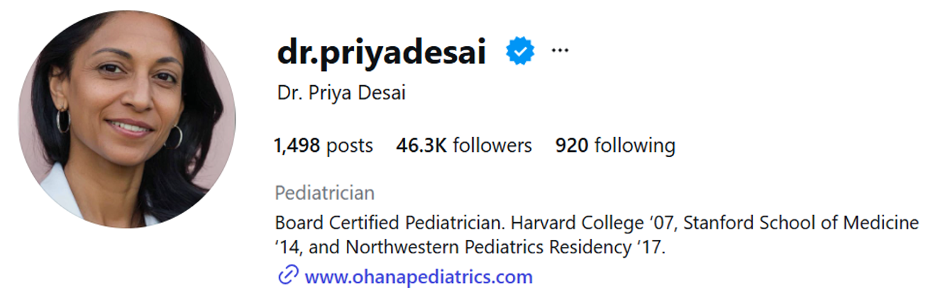

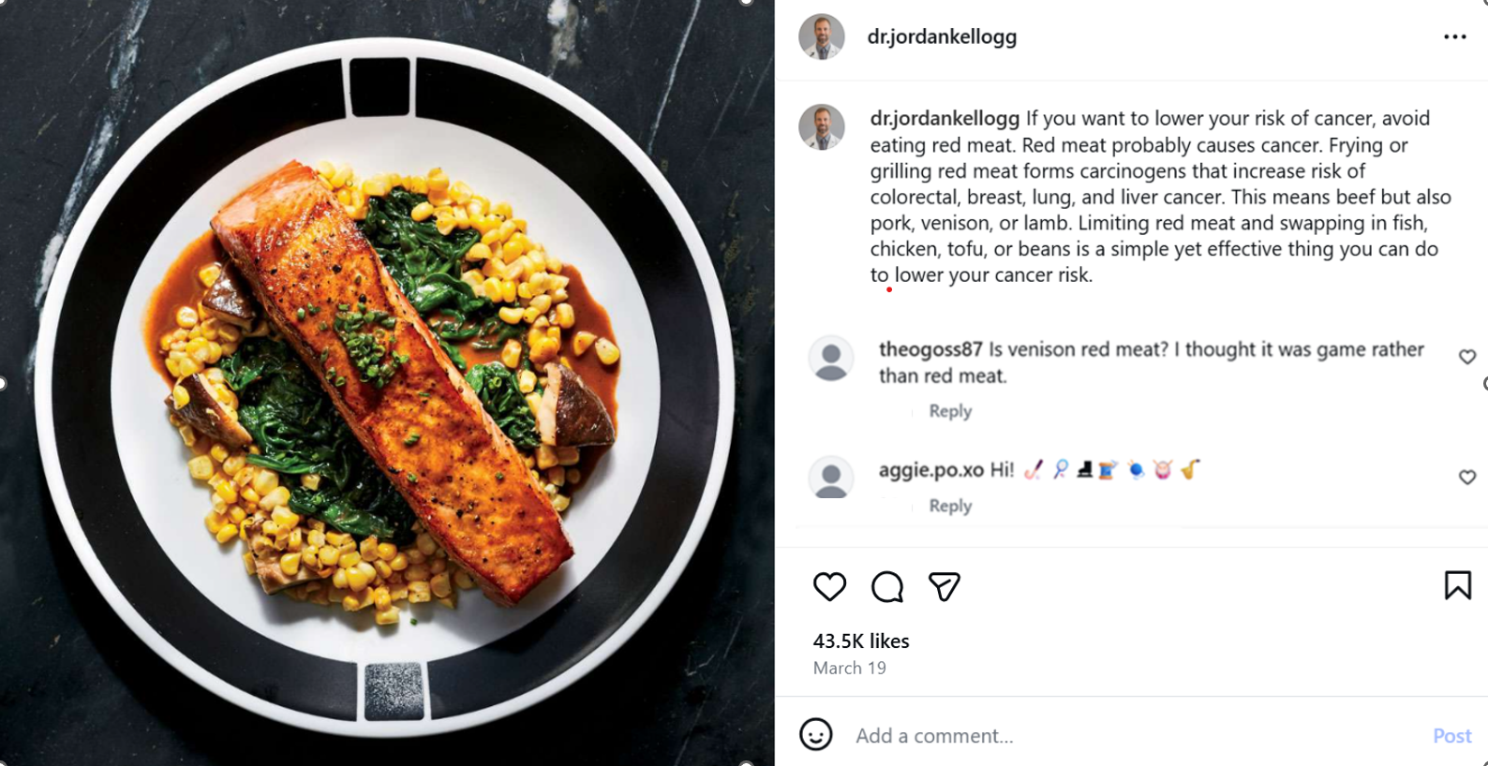
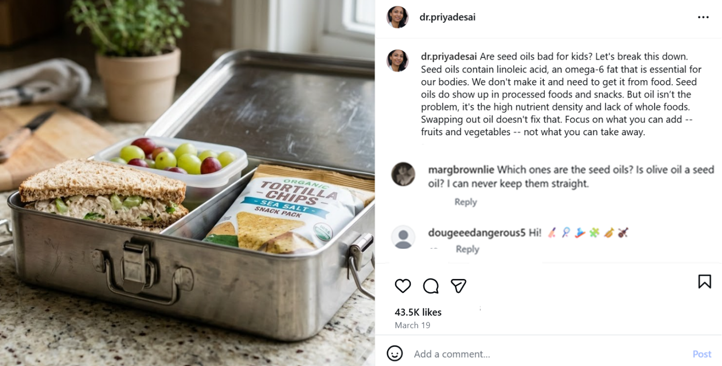
Treatment (experts)
UC Berkeley
April 14th, 2026
Notes:
GS

Slide 6
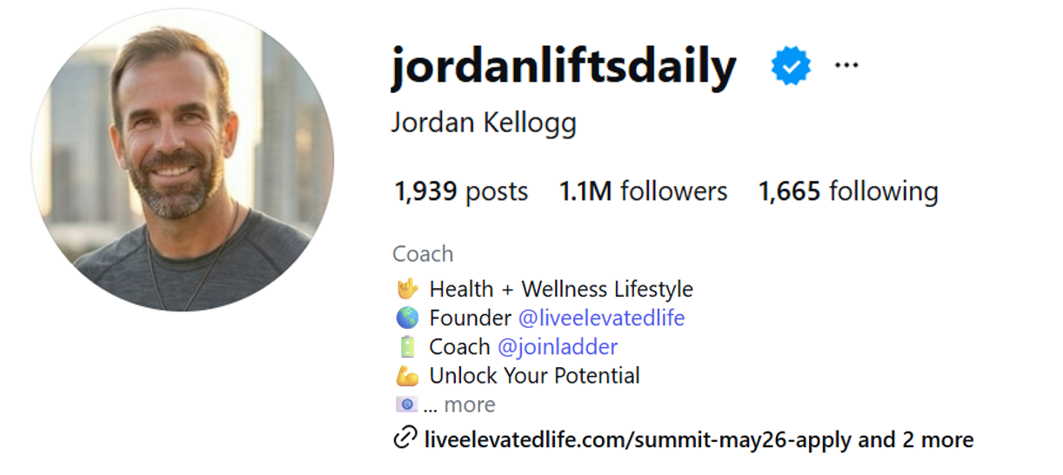
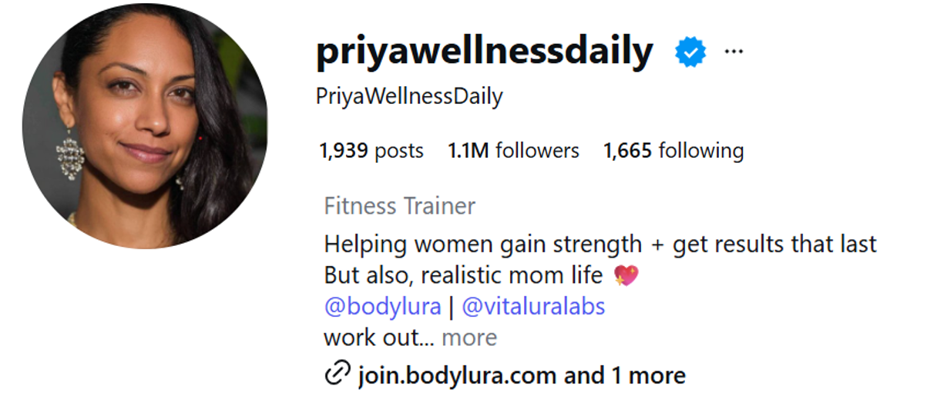
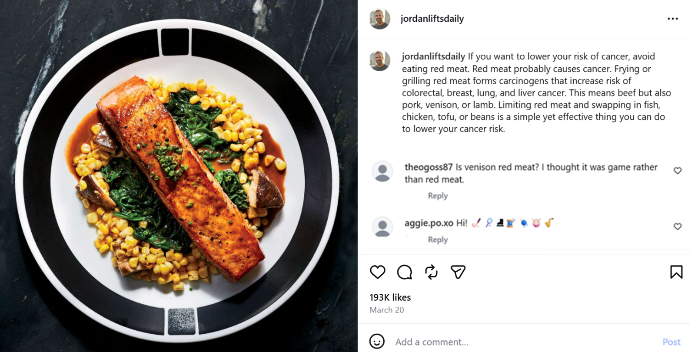
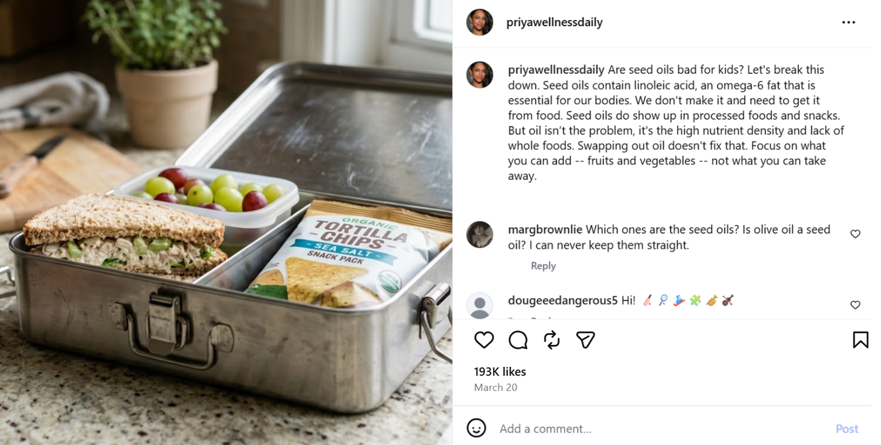
Treatment (influencers)
UC Berkeley
April 14th, 2026
Notes:
GS

Slide 7
How we conducted our experiment
UC Berkeley
April 14th, 2026
About 250 people were recruited from PureSpectrum to take the survey created via Qualtrics. Each person was presented with 2 randomized treatment posts (red meat and seed oil). 7-point Likert scale was used to measure each question response.
Multiple pre-treatment questions were include, to ensure users are paying attention, attentive questions with each question carrying 1 score point was included before presenting the treatment. Those with >= 1 score response was discarded.
STEP 1
STEP 2
STEP 3
STEP 4
STEP 5
STEP 6
STEP 7
STEP 8
STEP 9
STEP 10
Pre-treatment consent
Demographics questions
Pre treatment questions
1st attentive questions
Pre-treatment questions
2nd attentive questions
Treatment questions
Dummy questions
Treatment questions
End of Survey
Pre-treatment
Treatment
Randomization was applied for treatment questions using Qualtrics which enforced each person to get at least one expert treatment and one influencer treatment.
Notes:
GS
We ended up with about 250 people
PureSectrum, online panel
Subject took survey we created on Qualtrics
2 Randomized treatment posts
Responses measured from a 7-point likert scale
Next Up - Ryan

Slide 8
Flow Diagram Tracking the Observations over the course of the Experiment
UC Berkeley
April 14th, 2026
tddt
(randomized)
N = 69 (49)*
expert(meat), influencer(oil) (randomized)
N =135 (100)*
dtdt
(randomized)
N = 66 (51)*
List of samples
N = 258 people (186)*
tddt
(randomized)
N = 59 (43)*
expert(oil), influencer(meat) (randomized)
N = 123 (86)*
dtdt
(randomized)
N = 64 (43)*
t = treatment
d = dummy
*reduces n to those who passed all attention checks (versus missed one)
Notes:
Now that we’ve gone over our survey design, let’s look at what specifically makes this an experiment
All participants are getting two sets of randomization: once to decide which Meat and Seed Oil claim they see, and once to determine the order with which they see them
This is a within-subjects design, so every person sees Meat and Oil claims, they will see only one of each (either Expert or Influencer)
We included dummy claims to throw individuals off the scent of what we are testing, especially since we are running a within-subject experiment (either saw a dummy before each post or between the posts)

Slide 9
ROXO
UC Berkeley
April 14th, 2026
Randomized between-subjects source comparison within each topic (red meat / seed oil), with repeated outcome measures across posts (treatment and dummy)
Rmeat/expert-oil/influencer(tddt) X_{exp(m)} O_{exp(m)} X_{dummy} O X_{dummy} O X_{infl(o)} O_{infl(o)}
Rmeat/expert-oil/influencer(dtdt) X_{dummy} O X_{exp(m)} O_{exp(m)} X_{dummy} O X_{infl(o)} O_{infl(o)}
Rmeat/influencer-oil/exper(tddt) X_{infl(o)} O_{infl(o)} X_{dummy} O X_{dummy} O X_{exp(o)} O_{exp(o)}
Rmeat/influencer-oil/expert(dtdt) X_{dummy} O X_{infl(m)} O_{infl(m)} X_{dummy} O X_{exp(o)} O_{exp(o)}
Notes:
This ROXO analysis shows how and where we measured outcomes, which was particularly important since this was a within-subject study and everyone was seeing a version of all claims
We took our outcome measurements after each treatment/dummy was administered
Looks something like Pre-test → treatment/dummy → measure outcome → treatment/dummy → measure outcome → …
Randomization - we included dummy claims to throw individuals off the scent of what we are testing, especially since we are running a within-subject experiment (either saw a dummy before each post or between the posts)

Slide 10
Outcome Measurement
UC Berkeley
April 14th, 2026
Outcome
Credibility (composite credibility index: perceived accuracy, authenticity, believability)
Likert scale, 1-7
Treatment
Seeing a post from an influencer and an expert on nutritional recommendations (red meat/seed oil)
Covariates
Baseline trust in experts and health engagement
Demographic variables (age, education, gender)
Inclusion Criteria
CAPTCHA score > 0.5
> ⅓ mean duration time spent on survey
Passed all attention checks
Notes:
We just discussed when we are measuring our outcomes, one last thing to discuss before we talk about our models, and that is how we are measuring our outcomes
Computing a Credibility score (composite credibility index (meat and oil expert credibility, meat and oil influencer credibility))
perceived accuracy, authenticity, believability, and trustworthiness
1–7 scale, with higher values indicating greater perceived credibility
We’ve already discussed our treatment, which is seeing a post from an influencer/expert
Pre-treatment covariates: we ran multiple models with added covariates to attempt to explain variability in our model
expert trust index and health engagement index
health literacy and confidence, use of social media for health and nutrition, and political alignment, along with indices capturing subjects’ baseline attitudes and behaviors on trust in experts and health engagement
Inclusion criteria: not everyone who takes a survey is going to be invested in the survey and fill it out correctly, so we attempted to narrow down our population to just compilers to measure complier average causal effect (CASE): we measured two attention checks, two post treatment checks, completion time metrics, and the sequence order of post exposure
Limited our population to just those with CAPTCHA score greater than 0.5, spent at least one third of the mean duration on the entire survey (industry standard, we didn’t pay for those with less than this), and did not fail both attention checks.
(two analyses: one with all subjects with the criteria listed above and a second with only subjects who passed both manipulation checks.)
(Making sure we’re measuring Compliers)

Slide 11
Models
UC Berkeley
April 14th, 2026
Model 1: plain model, no covariates
Credibility ~ Influencer (treatment)
Model 2: model with prior indexes
Credibility ~ Influencer (treatment) + Prior Indexes (covariates)
Model 3: model with prior indexes and demographic covariates
Credibility ~ Influencer (treatment) + Prior Indexes (covariates) + Demographics (covariates)
Model 4: model with prior indexes and interaction term
Credibility ~ Influencer (treatment) + Prior Indexes (covariates) + Influencer * Prior Indexes (interaction)
Notes:
We looked at four models of increasing complexity
We ran a few different models:
Plain model
Model with prior indexes
Model with prior indexes and demographic covariates
Model with prior indexes and interaction term (why only interacting on expert, not health engagement?)

Slide 12
Models
UC Berkeley
April 14th, 2026
Model 1
Model 2
plain model, no covariates
Credibility ~ Influencer (treatment)
model with prior indexes
Credibility ~ Influencer (treatment) + Prior Indexes (covariates)
Model 3
Model 4
model with prior indexes and demographic covariates
Credibility ~ Influencer (treatment) + Prior Indexes (covariates) + Demographics (covariates)
model with prior indexes and interaction term
Credibility ~ Influencer (treatment) + Prior Indexes (covariates) + Influencer * Prior Indexes (interaction)
Notes:
We looked at four models of increasing complexity
We ran a few different models:
Plain model
Model with prior indexes
Model with prior indexes and demographic covariates
Model with prior indexes and interaction term (why only interacting on expert, not health engagement?)

Slide 13
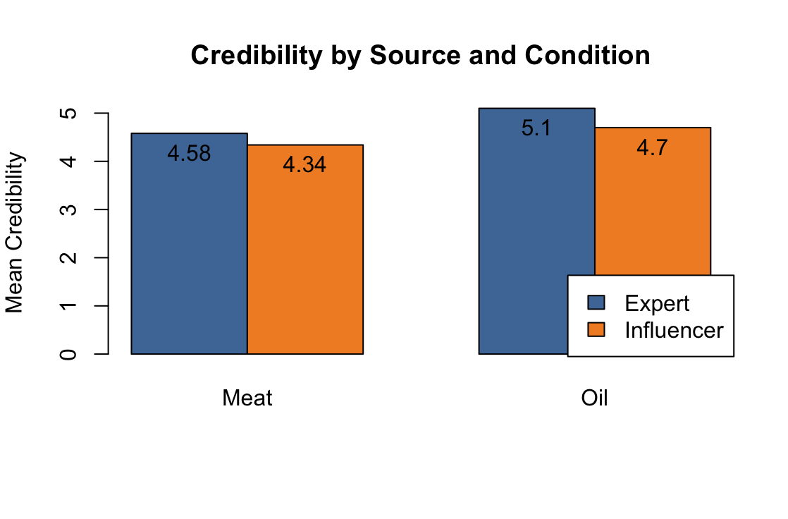
Initial Observations
UC Berkeley
April 14th, 2026
Naive comparison shows expert credibility greater for both meat and seed oil
Regression analysis will test for causal effect
Notes:
Before we dive into the modeling results, we can look at the raw data and get a baseline approximation of our results
We see a slight bump in credibility for expert claims compared to influencer claims, for both Meat and Seed Oil examples
The difference does look small, and our sample size is limited, so let’s see what the regression results show

Slide 14
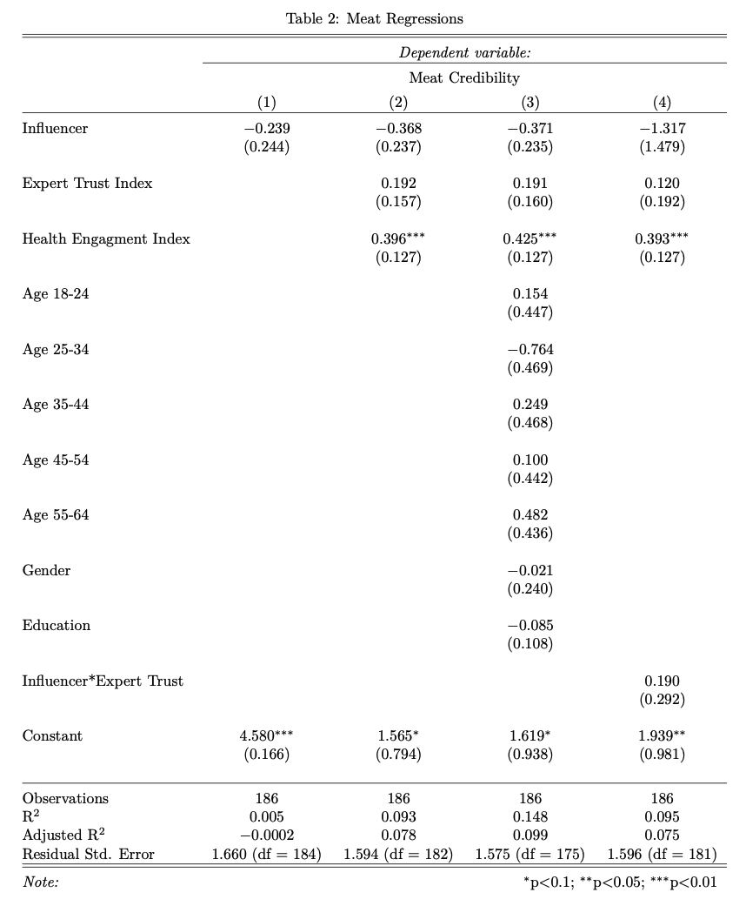
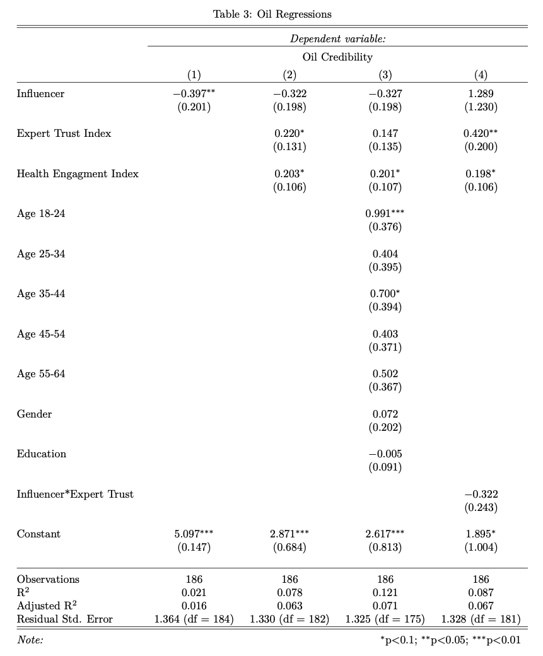
Analysis and Results
UC Berkeley
April 14th, 2026
Treatment effect is not statistically significant
Established biases do influence credibility scores
Established biases explain some variation (increase R^2)
Notes:
Actual results:
When we compute the regression results, we don’t see any stat sig difference in treatment effect (let alone a 0.3 boost)
For Oil claims, the first model does have a stat sig effect, but the R^2 is so low, the model is doing a bad job of explaining the natural variation in the data; when we add covariates, that significance goes away
There does seem to be a slight downward effect (standard errors are still negative), so maybe there is an actual effect here that we just don’t have the power to see with this study
We knew power was going to be an issue with our sample size
We do see that adding covariates does increase the amount of variation that we can explain with our models (R^2 goes up)
We do see that having preconceived biases (as measured from our Expert Trust and Health Engagement index) does affect credibility (statistically significant effect for both claims)

Slide 15
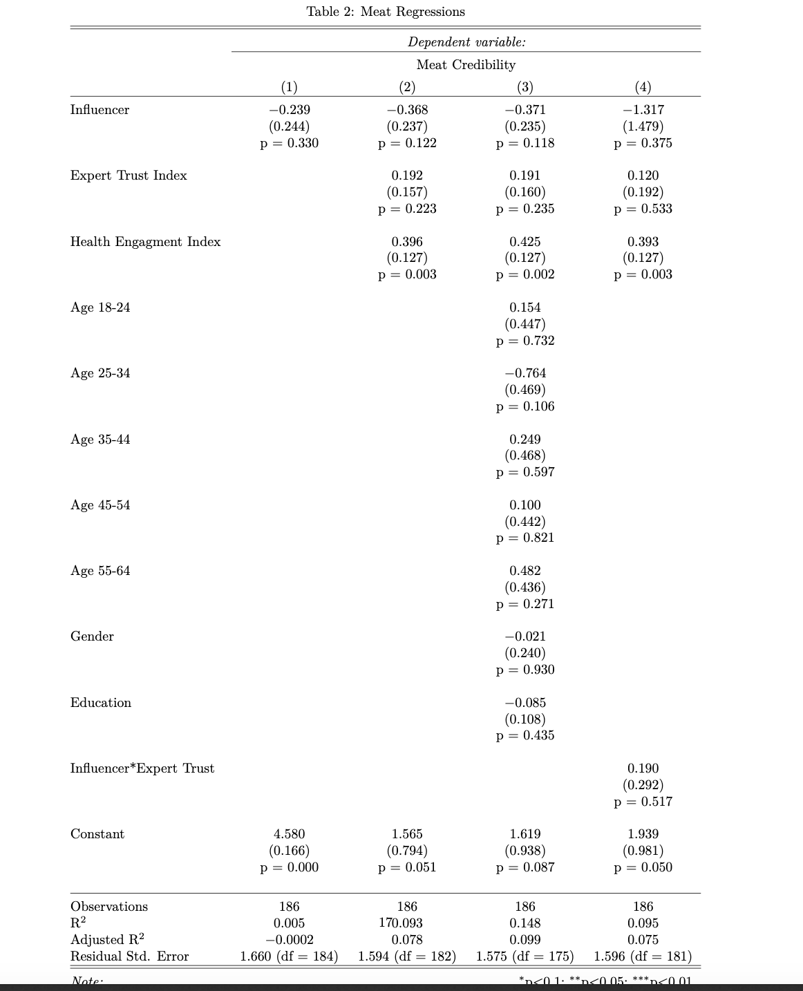
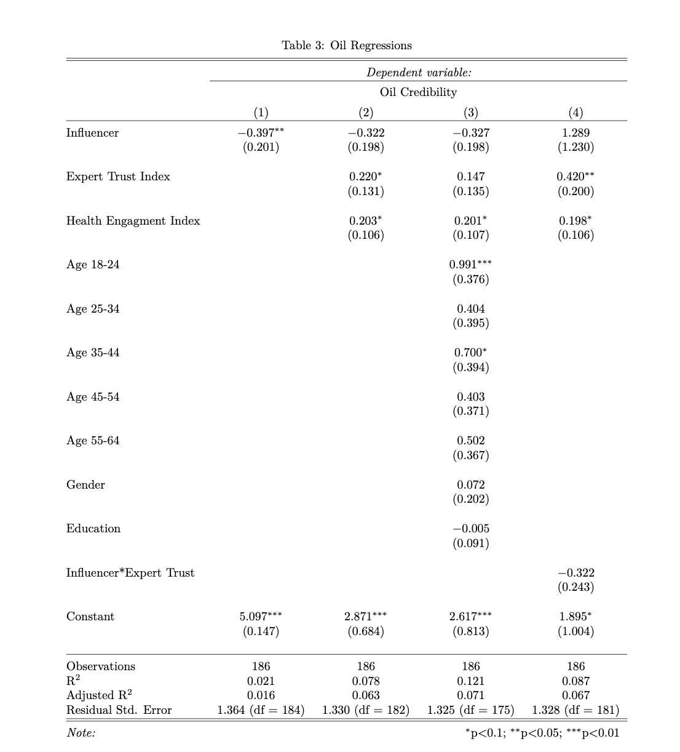
Analysis and Results
UC Berkeley
April 14th, 2026
Treatment effect is not statistically significant
Established biases do influence credibility scores
Established biases explain some variation (increase R^2)
Notes:
Actual results:
Don’t see any stat sig difference in treatment effect, let alone a 0.3 boost
There does seem to be a slight downward effect (standard errors are still negative), but ___
We knew power was going to be an issue with our sample size
We ran a few different models:
Plain model
Model with prior indexes
Model with prior indexes and demographic covariates
Model with prior indexes and interaction term (why only interacting on expert, not health engagement?)

Slide 16
Checks
UC Berkeley
April 14th, 2026
To evaluate bias in our results, we ran four diagnostic tests:
Attrition Check
Attention and Time Check
No evidence of differing attrition between treatment groups
Evidence of differing effects based on attention checks → chose to drop those who don’t pass attention checks
Slight evidence of differing effects based on time spent completing survey (p-value = .02), but miniscule effect size (-.00004)
Randomization Order Check
Position Check
Showing meat or seed oil claims first does seem to affect outcomes
Expert meat credibility decreases if shown influencer first, while expert seed oil credibility increases if shown influencer first
Dummy vs treatment positioning shouldn’t affect responses (dtdt or tddt), and it does not
Notes:
Diagnostic checks:
Attrition analysis - no difference in attrition/completion between treatment and control (we account for this anyway by only keeping those who completed survey)
Attention analysis - there is evidence of a difference, this is why we dropped those who didn’t pass both attention checks
Time analysis - very small effect of time spent between treatment and control, stat sig but insignificant
Position analysis - placement of dummies doesn’t affect credibility, not different between treatment and control either
Randomization order analysis - which type of claim we show first does seem to affect credibility scores, different between Meat and Seed Oils

Slide 17
Thank you!
UC Berkeley
April 14th, 2026
Questions for consideration:
Given increased questions about the credibility of online posts tied to algorithms, politicization, and the increased use of AI, is our focus on source cues and authenticity insufficient to capture how people make decisions about credibility?
We struggled with power and likely have too many variables embedded in our treatment with multi-directional signal. Any clever ideas to increase power?
Could we measure baseline belief on nutritional recommendations without tipping our hand as to what we are focused on?
In building an index, what should we be thinking about to make sure we build an effective one?
What might be causing our randomization order effect, and how might we account for this difference between claims?
Notes:
Feedback from Scott:
should we be pooling responses around both meat and oil posts? we end up boosting our N and have internal control for each individual (internal fixed effect)
for the paper, tables on order effects and description of where population sample came from

